Slide 1
Data Science and Openshift on the MOC
Michael Clifford | Anand Sanmukhani
Red Hat Inc.
Yousif | Zhuofa | Krishna | Fangya | Nihar | Ojasvi
Notes:
Fangya

Slide 2
Quick recap
Goal: Improve the Prometheus Anomaly Detection System and make it available to users on the MOC
Making PAD available via Open DataHub on MOC
Understand the current PAD data-pipeline, model and extending it by adding more anomaly detection models on other metrics tracked by Prometheus

Slide 3
Previous Sprint Review
Project Familiarization
Mass Open Cloud Openshift Kubernetes Open Data Hub Prometheus Anomaly Detection(PAD)
Openshift Tutorial
We went through a tutorial for OpenShift, which taught us the basic shell commands and introduced us to the workflow of running an OpenShift cluster.
VM Setup
We setup virtual machines with fedora images, and set up the openshift environment that we’ll be using for further development.
Notes:
Fangya

Slide 4
2nd Sprint Progress
PAD Familiarization
We reviewed the notebooks containing the data pipelines and models of the current implementation of PAD
Literature Review
Literature review of time series forecasting models focussing on LSTM architectures
Deployments
PAD was successfully deployed on the MOC
We deployed Open Data Hub on our local machine
JupyterHub
We have started to familiarize ourselves with running JupyterHub on MOC
Notes:
Krishna

Slide 5
What we learned
Better understanding of MOC, Open Datahub, containerization.
Better understanding of tools like Prometheus, Grafana, Jupyterhub
Understood data pipeline in the current Prometheus Anomaly Detector
Time series forecasting models (Sliding Average, ARIMA, SARIMA)
LSTM model architecture
Notes:
Krishna

Slide 6
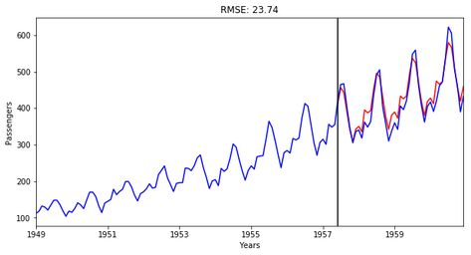
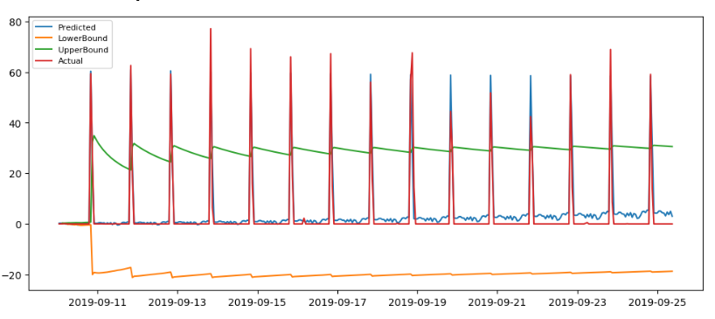
Sarima
Stands for Seasonal Autoregressive Integrated Moving Average
Analyzes univariate time-series data with a seasonal component
Notes:
Krishna
Autoregressive : linear comb of prev data

Slide 7
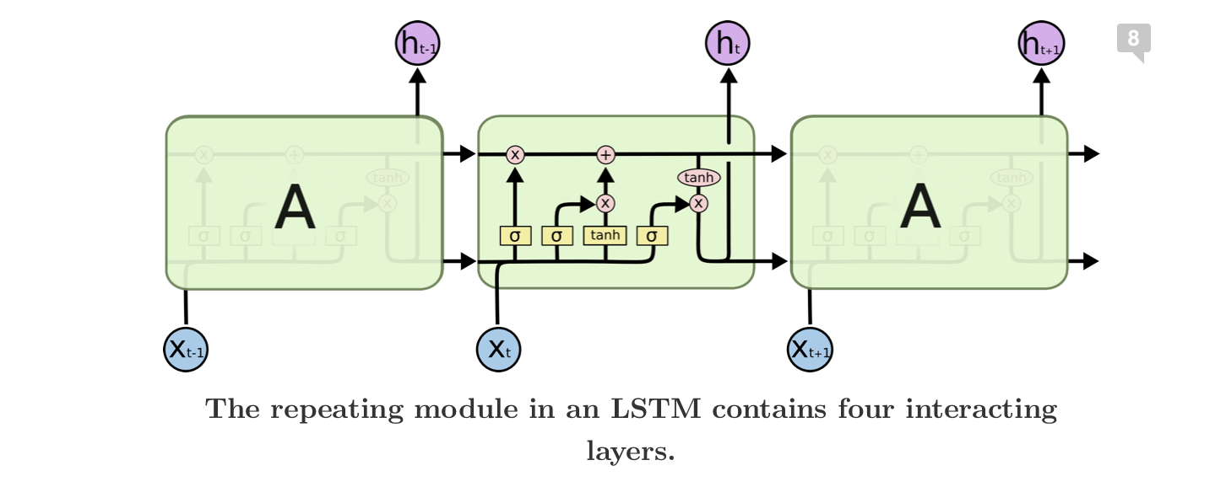
Long Short Term Memory Networks - LSTM
Why?
Understanding long term dependencies
State storage & propagation
Filter Gates, Forget Gates and Update Gates (3 gates)
Smart Initialization Technique (Cute Trick!)
Why Not?
Choosing Activation Functions
Memory Hog!
Notes:
Ojasvi
Example: In France, I had a really good time and learned a lot of ……… Language. - Neural Network - WTF? RNN - French
Why Neural Network
Why not traditional neural network (or why RNN)
Why not a regular neural network? (multiplication of weights)

Slide 8
Problems
Understanding how to interact with prometheus
Metric selection
Understanding limitations of the deployment
Resources
Time needed to train
Notes:
Ojasvi
Prometheus API. We need to play with it.
Metric Selection - Open Question
We don’t know the specifics of our deployment. We can’t have an MOC monitoring service use half of the MOC
We need to train the model every 15 mins. The model should completing the learning in 15 mins.

Slide 9
Demo
Notes:
Yousif

Slide 10
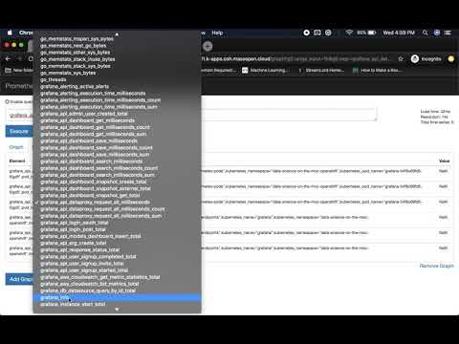
Notes:
Yousif

Slide 11
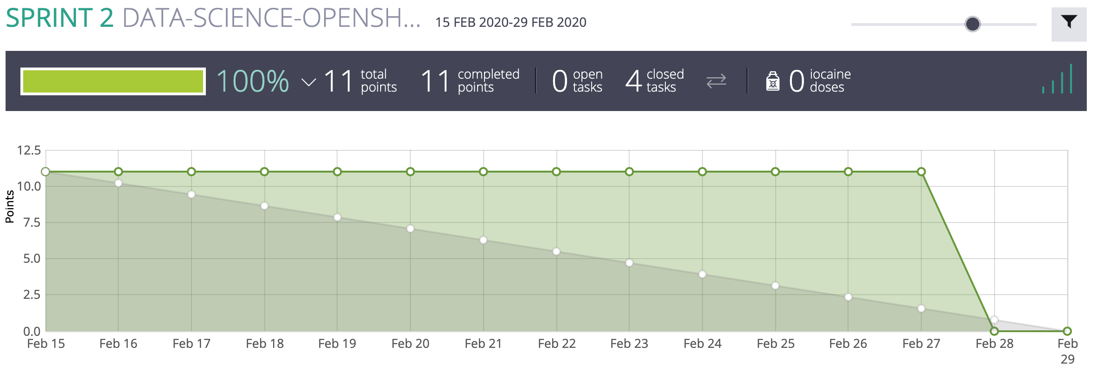
Burndown Chart
Notes:
Yousif

Slide 12
Next Sprint
JupyterHub Testing
Running memory heavy jobs on JupyterHub to test its bounds
Deploying PAD on MOC using a YAML file
Metric Selection
Understand the metrics that Prometheus is tracking for the JupyterHub application and picking 5 metrics to work on.
ML Model Implementation
ARIMA, sliding-average, and LSTM models on NAB dataset dataset (https://github.com/numenta/NAB/tree/master/data) which contains both real time cloud data and synthetic data
Prometheus API client Familiarization
Notes:
Nihar

Slide 13
Questions

